Slide 1
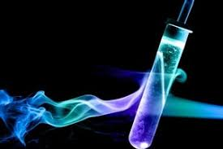
Energy changes in Chemistry

Slide 2
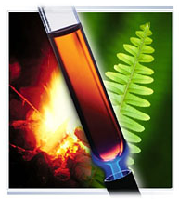
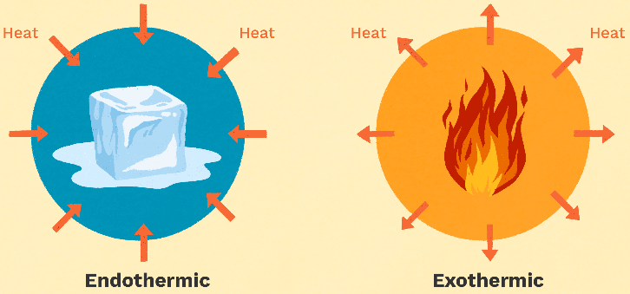
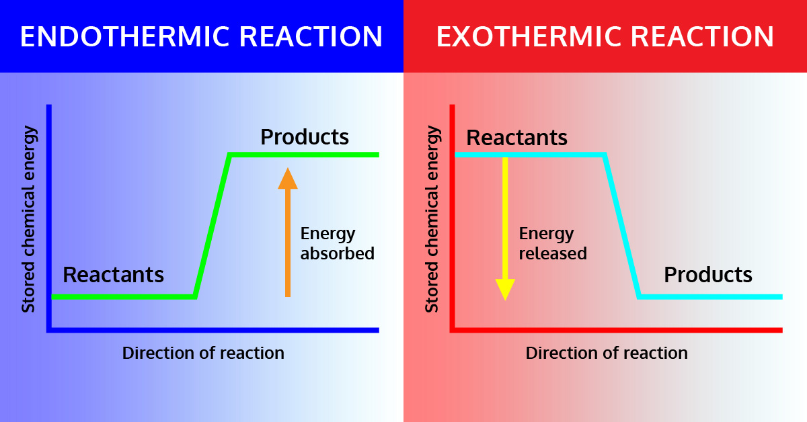
Outline
Part 1:
Chemical energy
Energy conservation
Exothermic and Endothermic Systems
Part 2:
Enthalpy
Energy profile diagrams

Slide 3
Outline: Part 1
Chemical and physical changes involve energy changes
In chemical reactions as the reactants rearrange, the chemical energy of the reactants also changes
We are going to learn how to classify chemical reactions based on their energy changes.
Pearson chapter 10.1

Slide 4
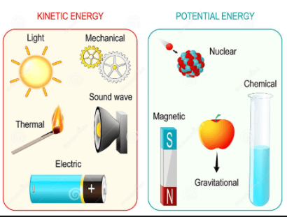
Energy
Energy is the capacity to do work or cause change
It is measured in joules (J)
Some forms of energy: heat energy, electrical energy, light energy, kinetic & potential energy and chemical potential energy
Energy is interchangeable, however the total amount of energy is always constant. Whenever one form of energy disappears or reduces in quantity, this results in an increase or appearance of another form
Law of conservation of energy

Slide 5
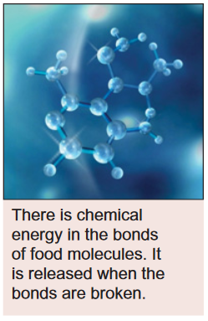
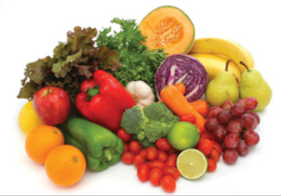
Energy
Chemical potential energy
Is a form of energy stored in the chemical bonds between atoms and molecules, it results from:
attractions between electrons and protons in atoms
repulsions between nuclei
repulsions between electrons
movement of electrons
Vibrations and rotations around bonds

Slide 6
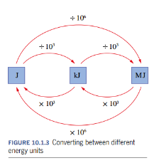
Energy
Standard units for energy
Standard units if joule, J
But we also use kilojoules, kJ and megajoules, MJ
1 MJ = 1000 kJ = 1 000 000 J
We cannot see bonds breaking and forming, but we can indirectly observe the energy change to looking at the effect the change has e.g. change of temperature, our bodies functioning
Ref: Pearson Year 11 Chemistry, WA edition.

Slide 7
Energy Conservation
Law of conservation of energy: energy cannot be created or destroyed. However, it can change form
If the energy in a substance reduced the excess must go somewhere…
If the substance needs more energy the energy must come from somewhere…

Slide 8
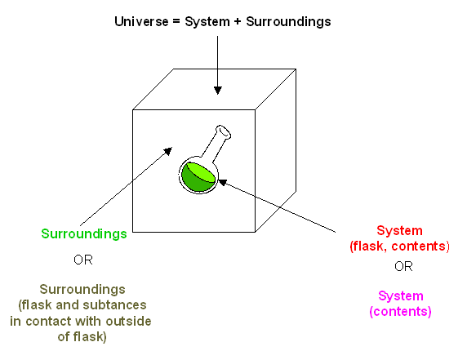
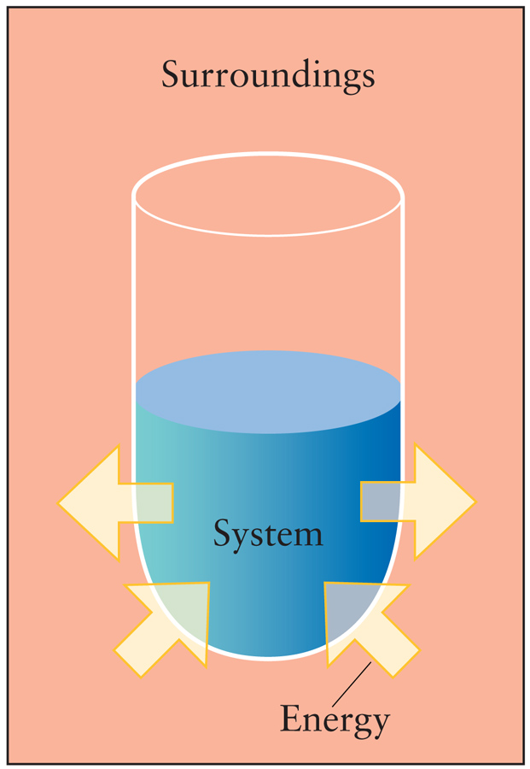
Energy Conservation – System and surroundings
When we discuss energy changes, we refer to a system and its surroundings

Slide 9
Energy Conservation – energy changes in a chemical reaction
Reactants have a certain amount of energy stored in their bonds.
The products that form in a chemical reaction have different bonds and therefore a different amount of chemical potential energy
Energy will be released or absorbed depending on the relative energy of the reactants and products
Higher energy
Where did extra come from?
System absorbs energy
high
Products
Energy
reactants
lower energy
Where the extra energy go?
System releases energy
products
low

Slide 10
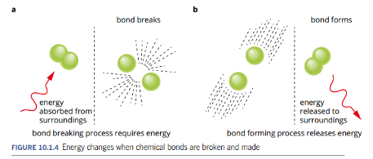
Energy Conservation – energy changes in a chemical reaction
Recall – stable = low energy state.
Particles bonded together are stable, so lower energy. Particles split apart are less stable, so higher energy
Breaking bonds – requires energy
Forming bonds – releases energy
It’s a balancing act, bonds breaking vs bonds forming determines if the products will be higher or lower energy than the reactants
Ref: Pearson Year 11 Chemistry, WA edition.

Slide 11
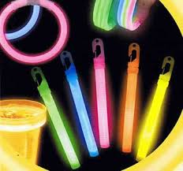
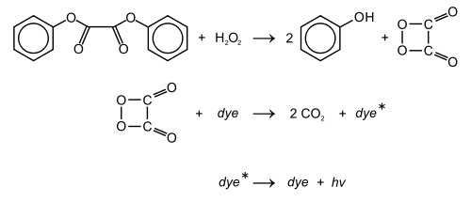
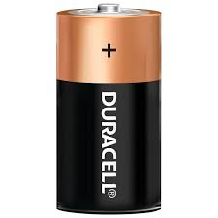
Energy Conservation – energy changes in a chemical reaction
energy is either absorbed or release from the system to the surroundings typically in the form of thermal (heat) energy
However, chemical potential energy can also be transformed into light energy, electrical energy, and movement (kinetic energy).
battery– chemical potential energy into electrical energy
Glow sticks – chemical potential energy into light energy

Slide 12
Exothermic and Endothermic Systems
Break down the words to remember their meaning.
Thermic – like thermal, relates to temperature
Exo – like EXIT, energy exits the system
Endo – like ENTER, energy enters the system

Slide 13
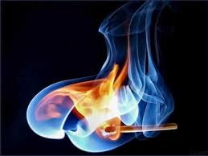

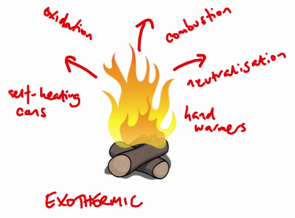
Exothermic and Endothermic Systems
Exothermic reactions
A chemical reaction that releases energy is called an exothermic reaction
Total energy of products < Total energy of reactants
Total energy of products is less than the total energy of reactants, so energy is released from the system into the surroundings
reactants → products + energy

Slide 14


Exothermic and Endothermic Systems
Examples of exothermic reactions:
Combustion reaction:
Hydrogen and oxygen to give water:
Neutralisation reactions (acid + base):
Redox reactions (e.g. thermite reaction):
Less stable
More stable
+ heat energy
+ heat energy
+ heat energy
https://www.youtube.com/watch?v=CWMATrOatRw

Slide 15
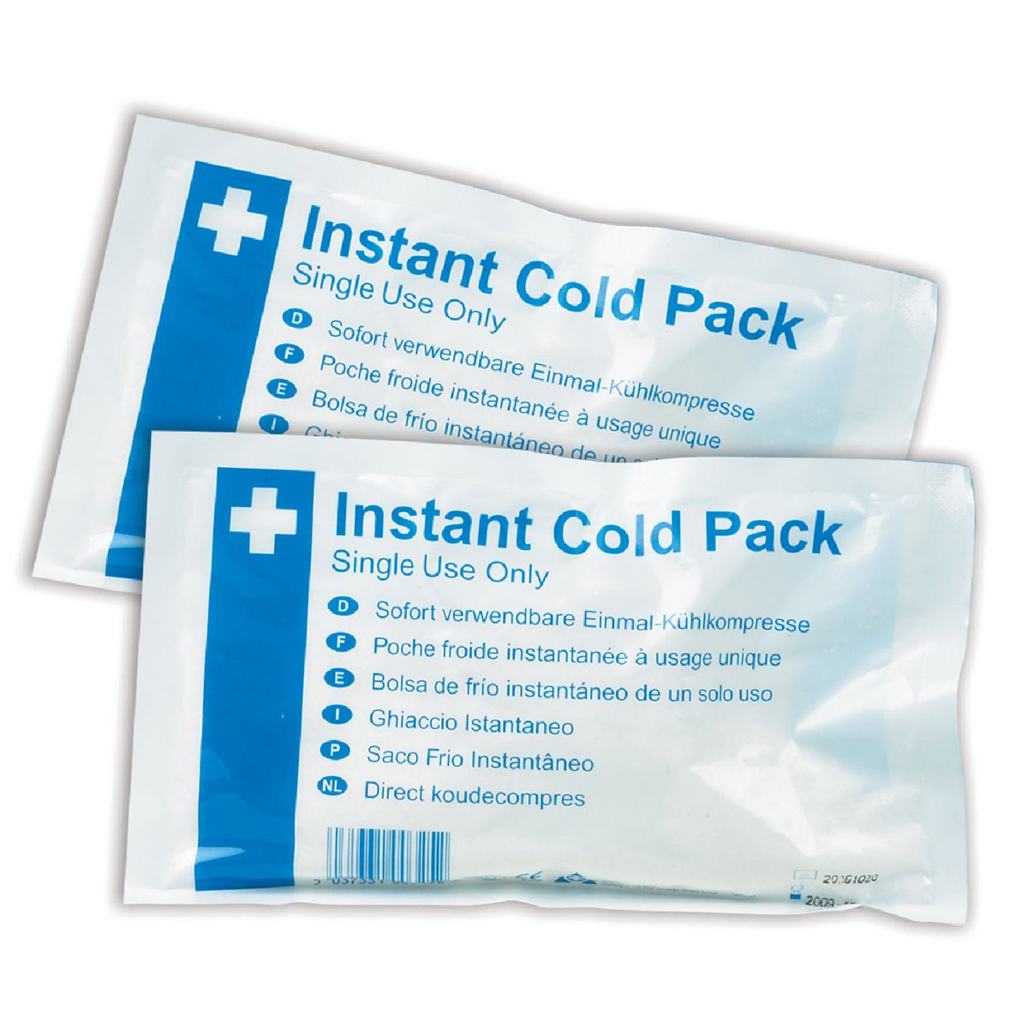

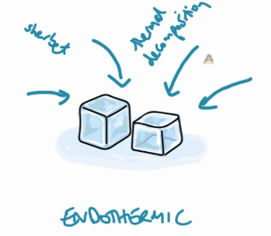
Exothermic and Endothermic Systems
Endothermic reactions
A chemical reaction that absorbs energy is called an endothermic reaction
Total energy of products > Total energy of reactants
Total energy of products is more than the total energy of reactants, so for the reaction to occur it need to gain energy from the surroundings
Reactants + energy → products

Slide 16
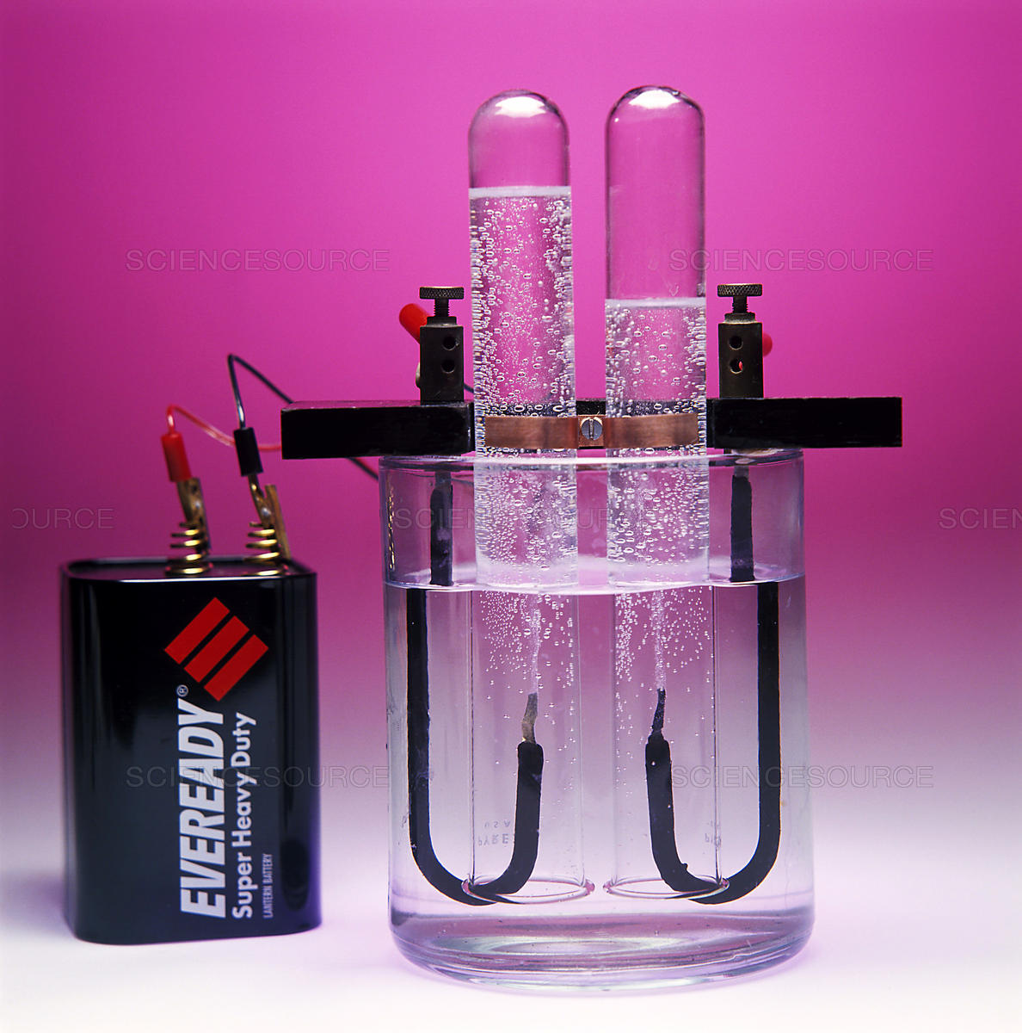

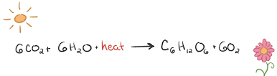
Exothermic and Endothermic Systems
Examples of endothermic reactions:
Barium hydroxide plus ammonium chloride
Decomposition of water by electrolysis
Photosynthesis
Energy +
More stable
Less stable

Slide 17
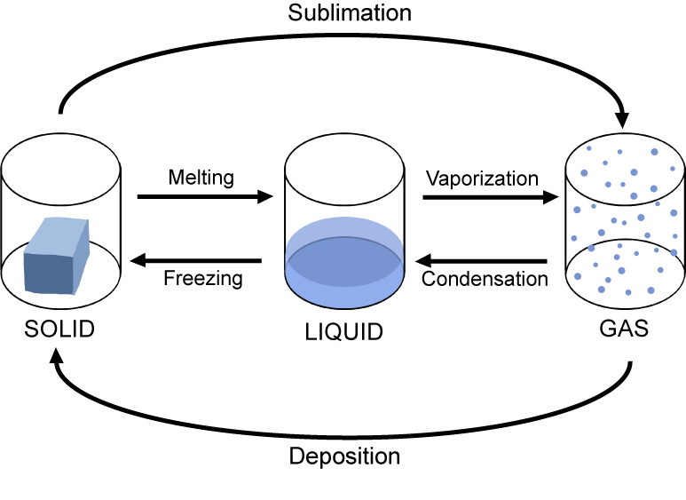
Exothermic and Endothermic Systems – phase changes
Phase changes also involve changes in the energy of the system
Some processes are exothermic and some endothermic

Slide 18
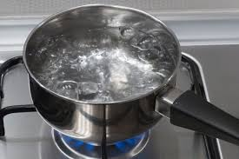
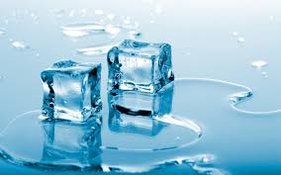
Exothermic and Endothermic Systems – phase changes
Evaporation – liquid to a gas
Melting – solid to a liquid
General
Ordered system, molecules close together – Stable so lower energy
Disordered, molecules spaced out – less stable, higher energy
Is this process exothermic or endothermic?
What is the system?
What is the surrounds?
Where is the energy coming from?

Slide 19
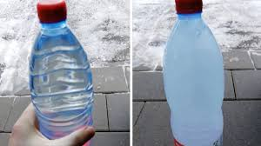

Exothermic and Endothermic Systems – phase changes
Freezing – liquid to solid
Condensing – gas to liquid
General
Ordered system, molecules close together – Stable so lower energy
Disordered, molecules spaced out – less stable, higher energy
Is this process exothermic or endothermic?
What is the system?
What is the surrounds?
Where is the energy coming from?

Slide 20
Questions
1) Which of the following statements about combustion reactions is correct?
Combustion reactions are usually exothermic, meaning energy is absorbed during the reaction
Combustion reactions are always exothermic, meaning energy is absorbed during the reaction
Combustion reactions are usually endothermic, meaning energy is absorbed by the system
Combustion reactions are always exothermic, meaning energy is released during the reaction.
2) Convert the following energy values to kJ
0.180 MJ
1.5 x 10⁶ J
10.0 J
2.0 x 10⁻³ J
3) Explain the difference between the terms ‘system’ and ‘surroundings’ in relation to a chemical reaction.
4) Explain the term ‘endothermic’ in relation to the total amount of chemical potential energy of the reactants and products

Slide 21
Answers
D
A) 180 kJ B) 1.5 x 10³ kJ C) 0.0100 kJ or 1.00 x 10⁻² kJ D) 2.0 x 10⁻⁶ kJ
In chemistry, the system is usually the chemical reaction, whereas the surroundings refer to everything else, for example, the beaker or test-tube in which the reaction takes place
In any reaction, the total amount of chemical energy of the reactants is made up of the bonds between atoms within the reactants. If the total amount of chemical energy within the reactants is less than the total amount of chemical energy within the products, energy must be supplied to the system, and the reaction is said to be endothermic.

